Slide 1
Savitribai Phule Pune University Bachelor of Business Administration (Computer Application) Academic Year: 2020 – 2021
Car Rental SYSTEM
A Project Review
By
TEJAS v. valame & Atharva n. rao
MAEER’s MIT Arts, Commerce and Science College Alandi (D)Pune-05

Slide 2
Introduction to System
The Car Rental Service system is being developed for customers so that they can book the vehicles from this system. This application takes information from customers through filling their details. A customer being registered in the system has the facility to book a vehicle which he/she requires. The proposed system is completely integrated desktop based systems. It’s a manual procedure in an effective way. This automated system facilitates customers and provide to fill up the details according to their requirements. It includes types of vehicles they are trying to hire according to their location. The purpose of this system is to develop a desktop based system application for the person who wants to book their vehicles along with their requirements.

Slide 3
Scope of System
This new system allows security to the data, by means of authorized users. Only the admin having a valid user name and password can access the material.
Rest all users can view only the basic information.
The proposed system provides information about the system details.
Front end provides faster interaction, while back end provides interaction with records.
The new system will allow the admin to quickly insert, delete, update and retrieve data from the system.

Slide 4
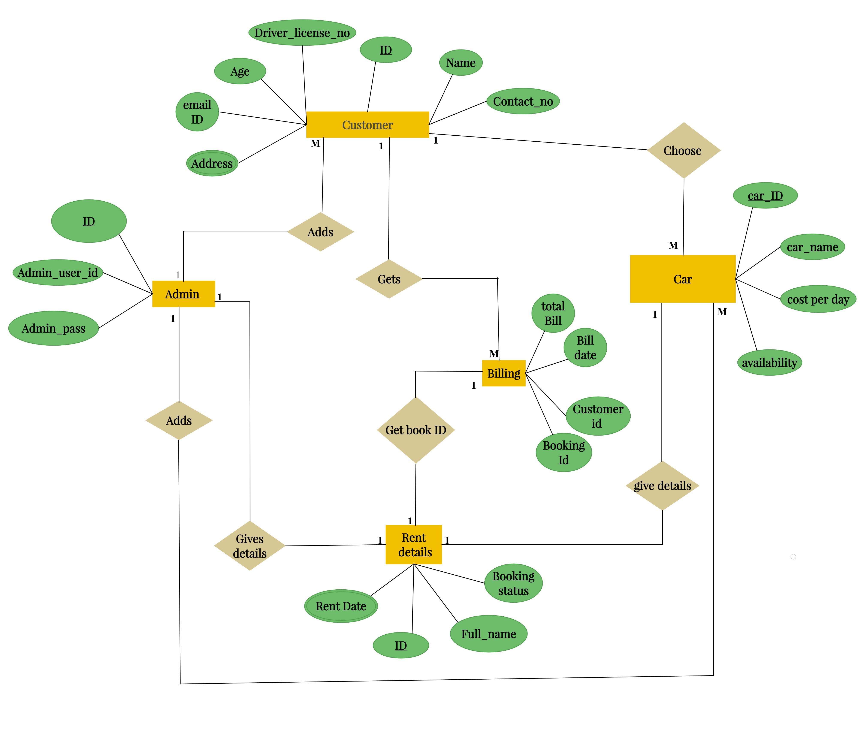
Entity
Relationship
Diagram

Slide 5
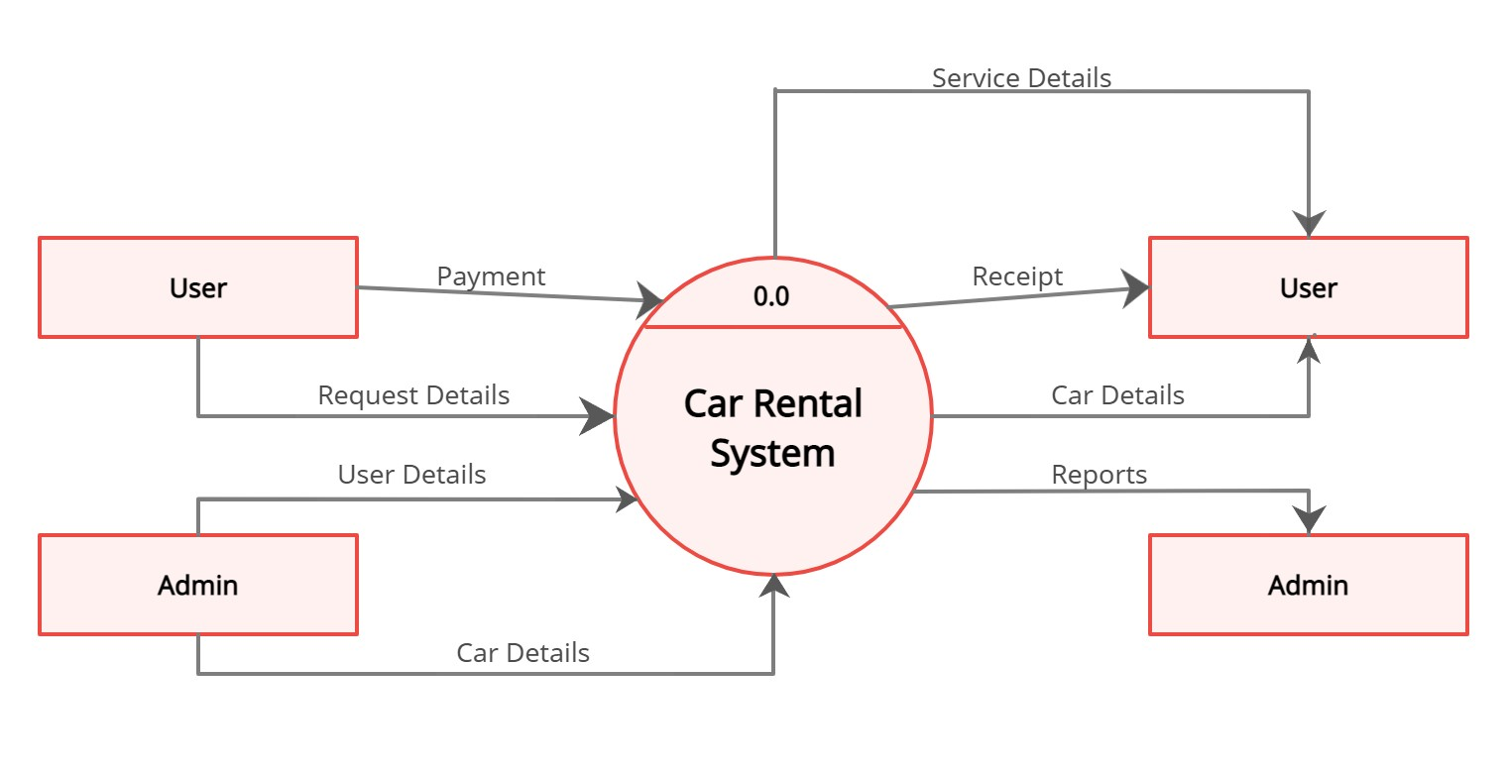
Context
Level
Diagram

Slide 6
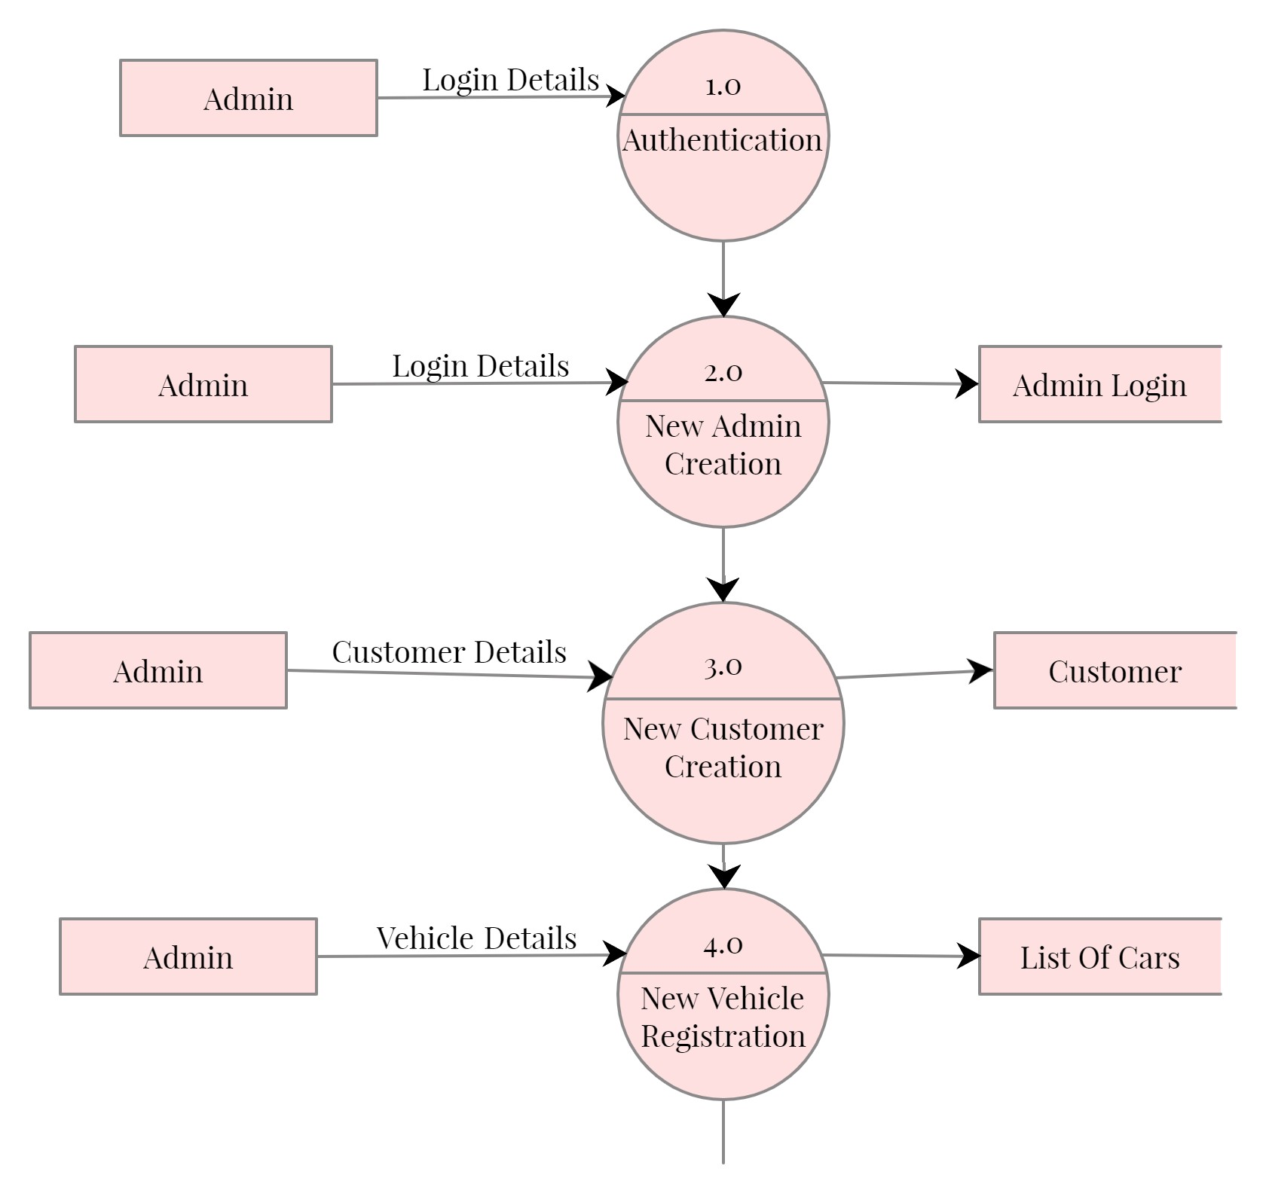
Data
Flow
Diagram

Slide 7
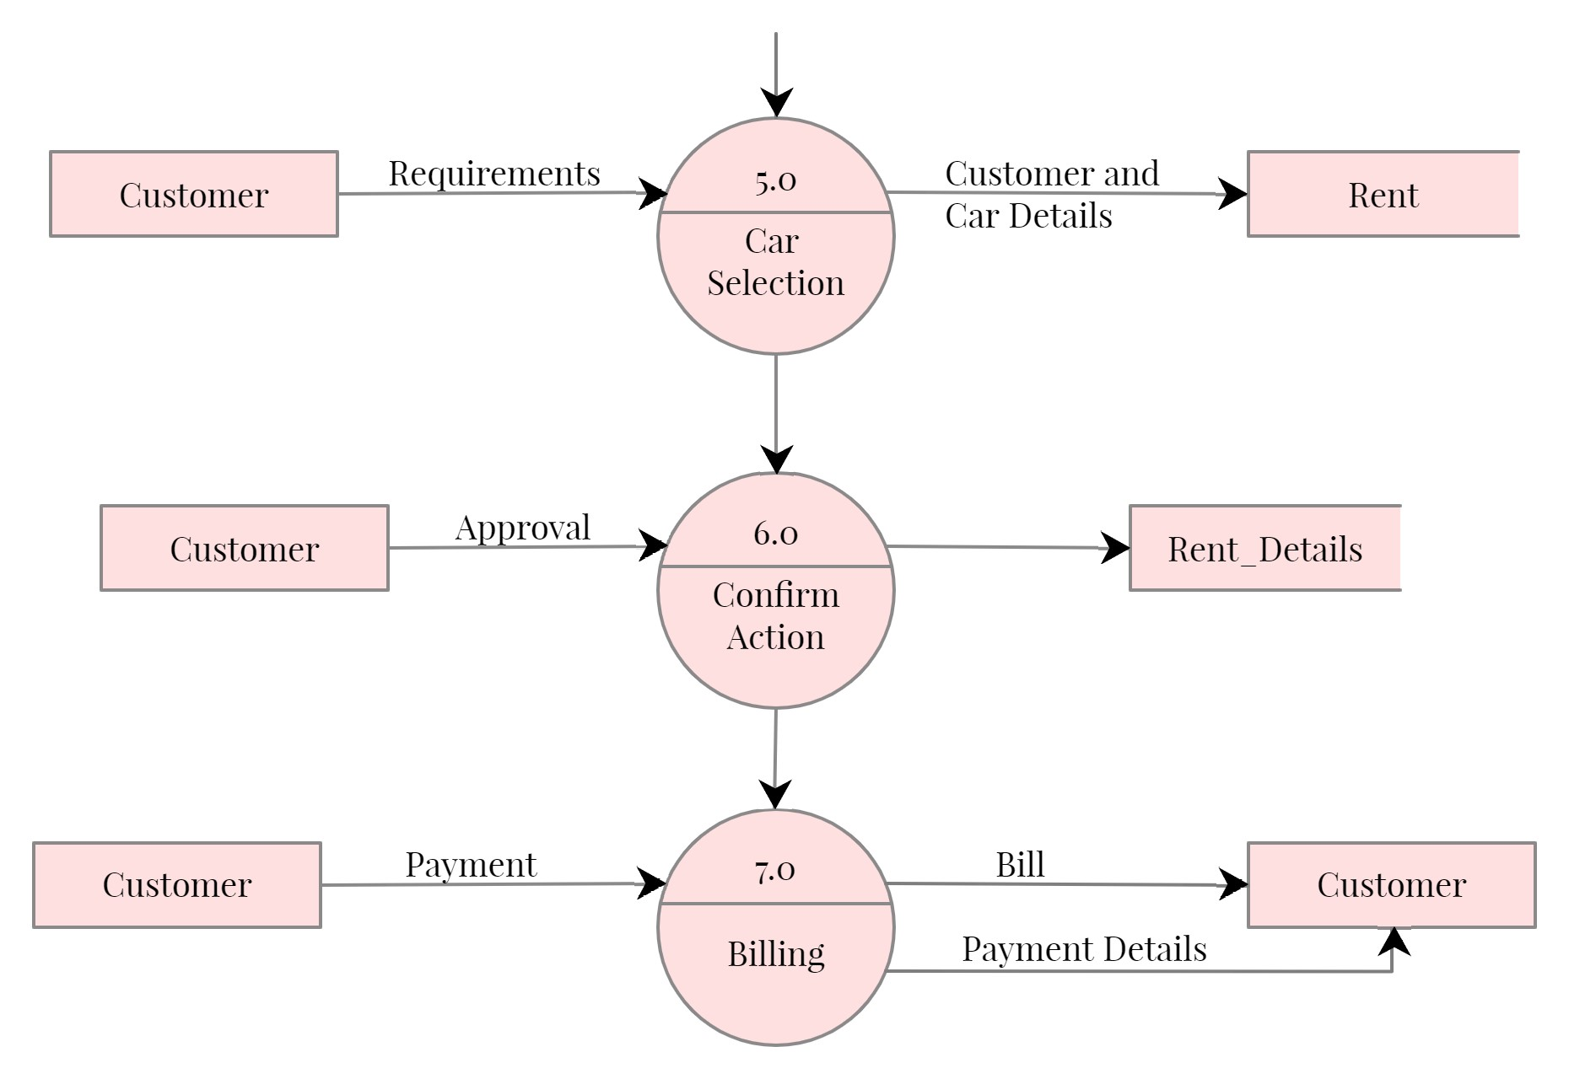

Slide 8
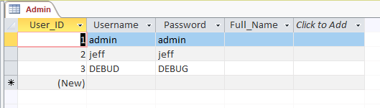
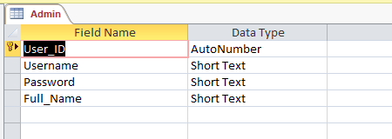
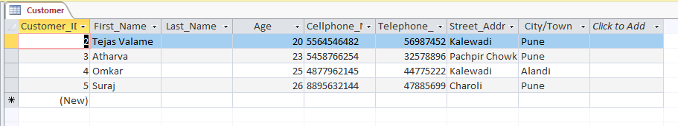
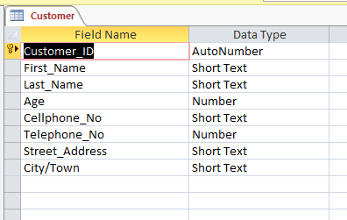
Data Dictionary
Admin Login:
Customer Table:

Slide 9
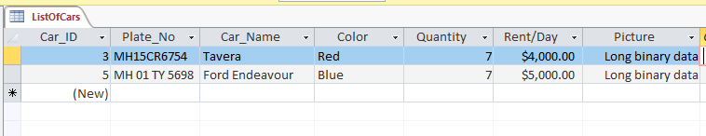
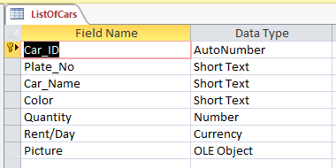
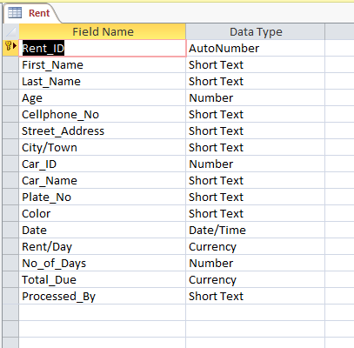
List of Cars:
Car rent:

Slide 10
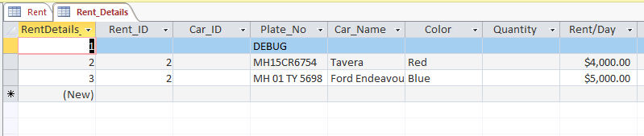
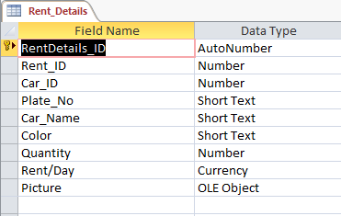
Rent Details table for billing:

Slide 11
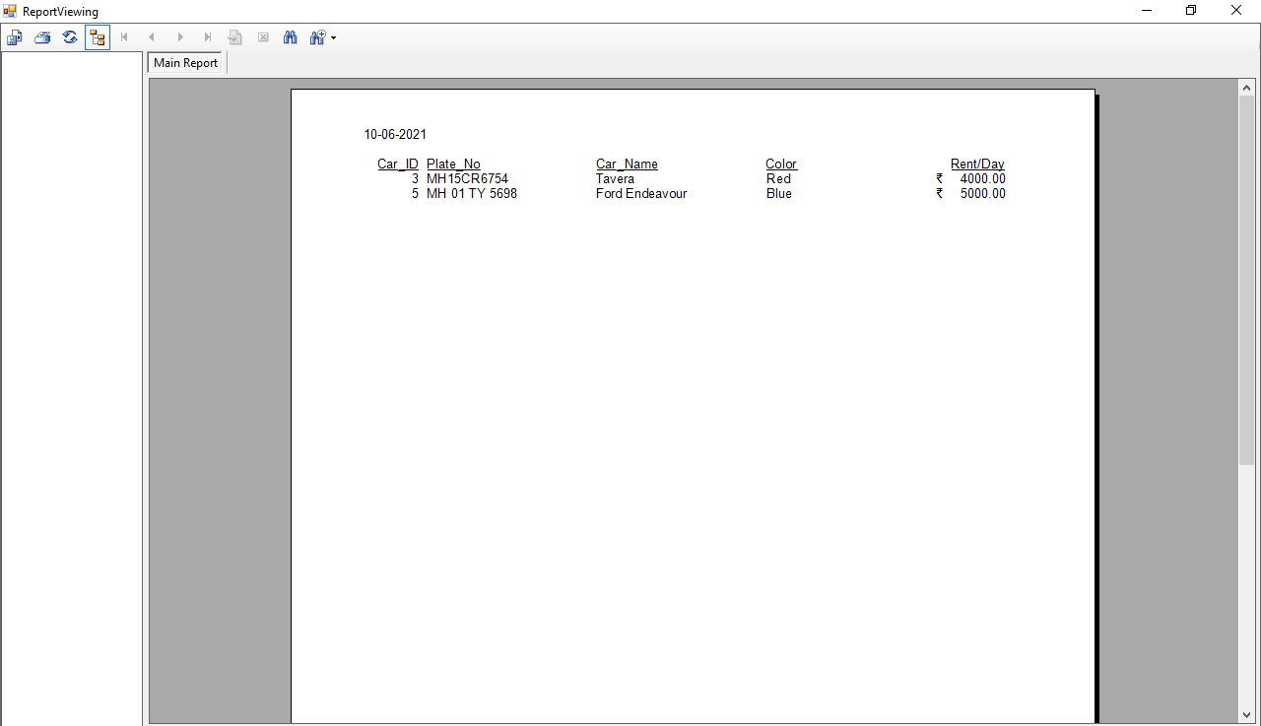
Reports

Slide 12
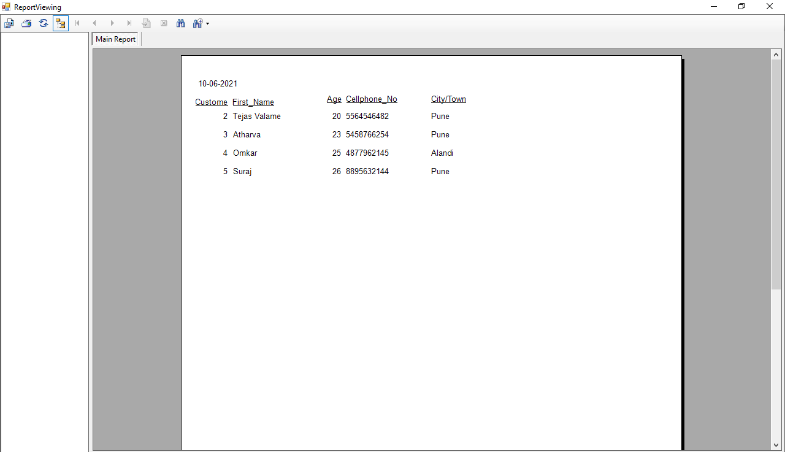

Slide 13
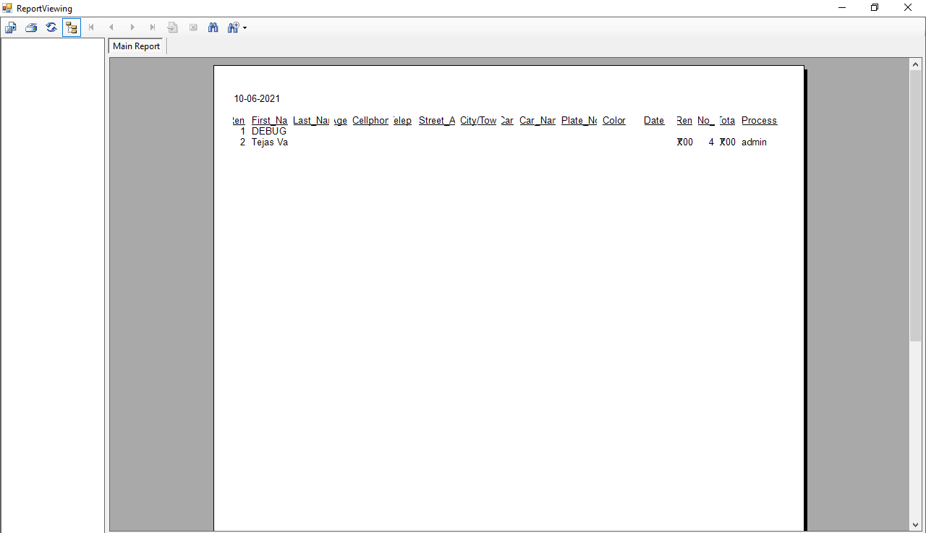

Slide 14
Advantaged & Limitations
Advantages:
The system is convenient to use as the user need to have basic knowledge about computer system.
Managing vehicle records is simple. Records like date of booking and available cars.
The system generates the bills as the admin sees fit and all the details are shown in the final bill.
Reliable.
The major advantage is that the system is computerized, so, there is less room for error.
The admin can view a detailed report about all the transactions done in the system.
Limitations:
The first limitation is that the system is offline.
Only the Admin can use this system, if the customer has to hire a car then they has to ask the admin.
As the system is not online the customer has to physically visit the rental shop.

Slide 15
Future Enhancements
In a nutshell, it can be summarized that the future scope of the project circles around security and upgrading to online system.
Create the master and slave database structure to reduce the overload of the database queries.
Implement the backup mechanism for taking backup of codebase and database on regular basis on different servers.
We can also add more complex features, and try to make it more user friendly.
By upgrading it online we can also add more features like live tracking and secure GPS system.

Slide 16
Thank You

